Slide 1
CubeSat Team
By: CDTs Gohar, Gover, Nguyen, Placke and Valle
Product Owner: LTC Craig Boucher
Faculty Advisor: LTC James Finocchiaro

Slide 2

Project Overview
Five-year program
"Brain" of the cube satellite
Military, assist in defense, and gathering information
Universal enough to support multiple sub-models
Outcomes: Physical structure of the cube satellite, the command and data handling systems, TT&C (telemetry, tracking, and control systems), and power.
Notes:
Our project at a high level consists of creating the brains of a cube satellite that will accompany a larger military satellite and assist in defense and gathering sensor information by co-orbiting with the larger military satellite. With the brain of the CubeSat created, our product owner can then attach any payload they need at a future date. Early discussions involve sensor cube satellites that will be responsible for gathering data. This sub-model CubeSat will gather data about the area around the military satellite and sending it to the military satellite for its own use. Another sub-model, the defense satellites, will be equipped with anti-satellite and anti-debris gear and be able to repel actions done against the main satellite or from any environmental dangers such as loose debris. The actual payloads for these future satellites are not in the scope of this project but our brain system will enable any future payloads. The motivation for this project comes from a need to ensure that data gathering satellites operated by the United States Government are not compromised and can continue their mission. The deliverable we intend to produce contains the base components for any sub-model of cube satellites. A key feature of our deliverable will be its universality as we intend for our brains to be used for multiple sub-models. Our deliverable will include the physical structure, the command data handling systems to include comms equipment, telemetry, tracking, and control systems, and power. The brains of the cube satellites will act as a foundation for later iterations of this project as our product owner has specified that this is a 5 year project. Our main goal is to create an operational prototype of the CubeSat that is capable of long distance and short distance communication and handling of data. In addition to our physical deliverable, we will also produce a github repo. This repo will contain the code we have written for data handling and the creation of a data stream to send back to the ground station.

Slide 3
Sprint Goal
Develop a functional block diagram which will layout the components in the CubeSat and a parts matrix for each major component.

Slide 4
Sprint Hours
Allocated Time: 140
Actual Time: 148.5
 | Planned Hours | Actual Hours
Knowledge Acquisition | 43 | 44
Work Environment Setup | 4 | 4
Requirements Generation | 19.5 | 16
Design Diagramming | 48 | 48
Project Communication | 33 | 29

Slide 5
Demonstration of Results
Trello – Burn down chart
Product Matrices
Block diagram

Slide 6
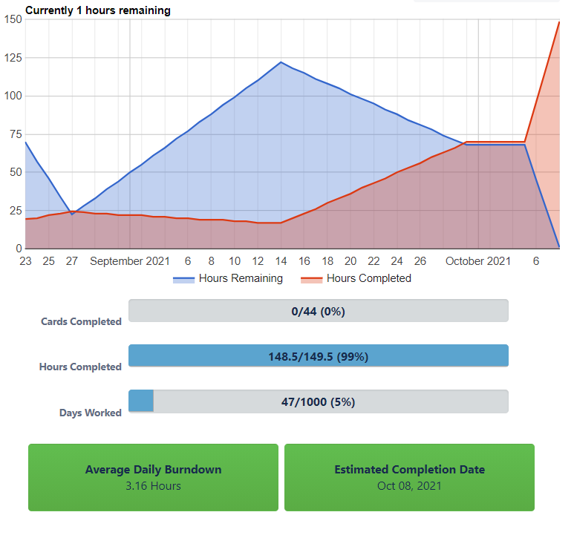
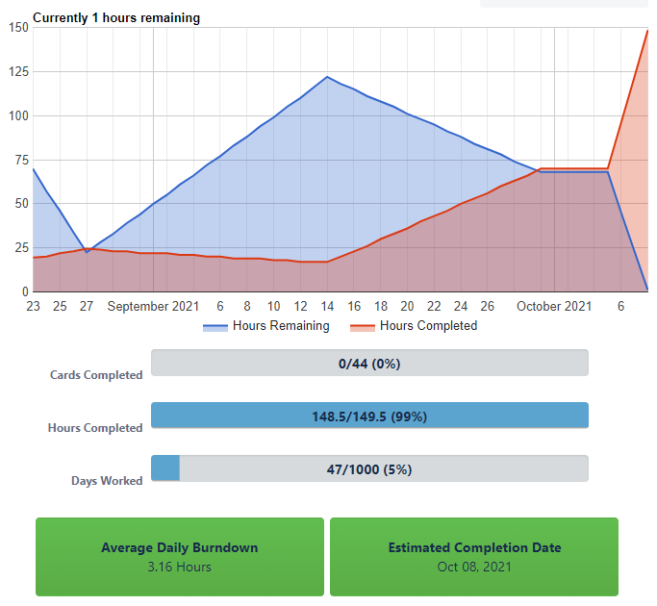
Trello

Slide 7
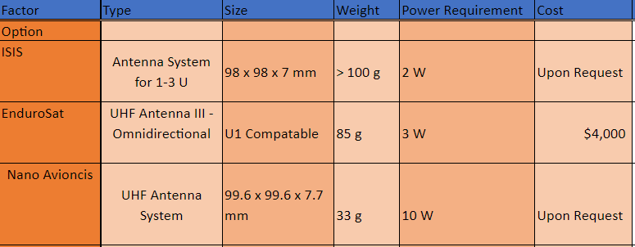

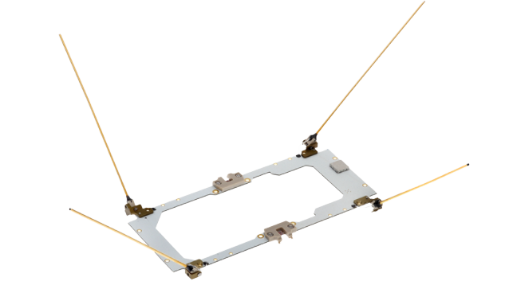
UHF Antenna

Slide 8
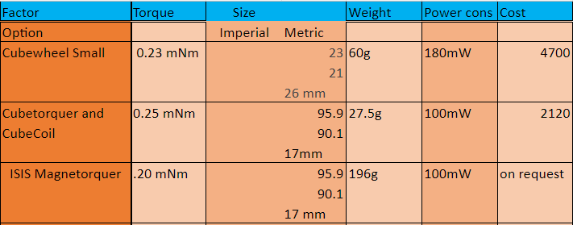
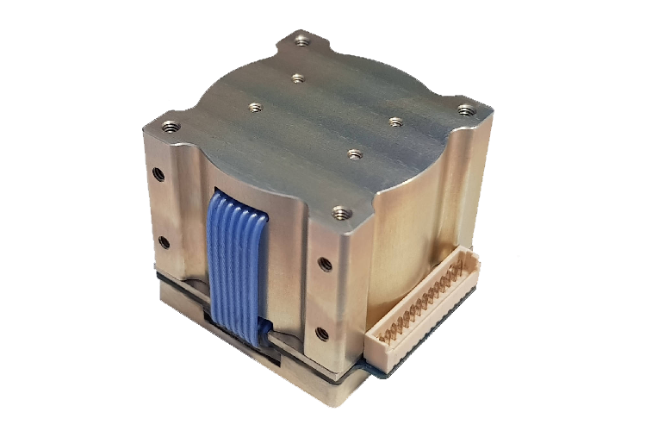
Attitude Control

Slide 9
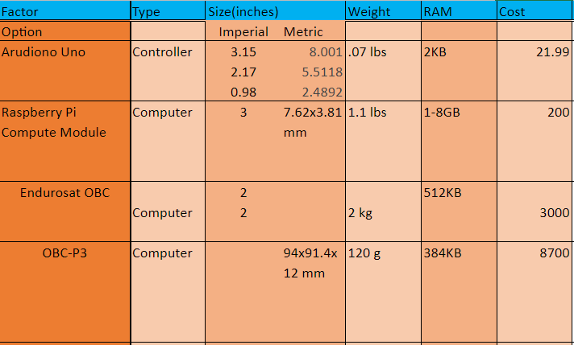
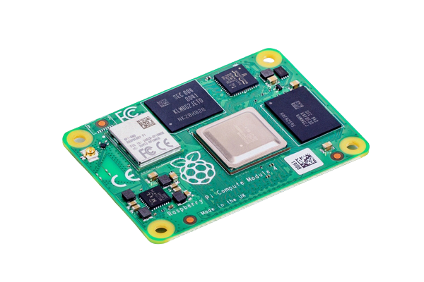
Computer Controller Matrix

Slide 10
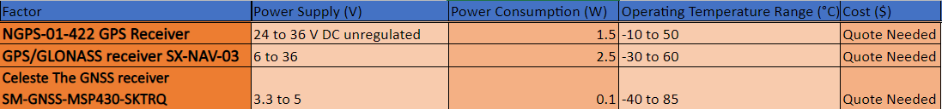
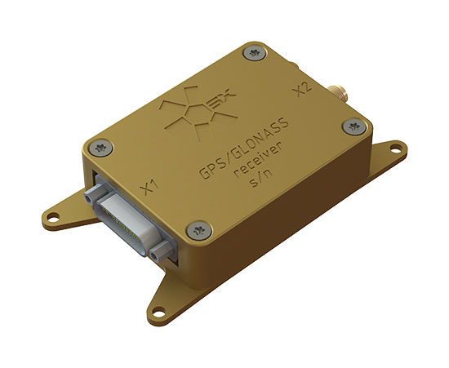
GPS System

Slide 11
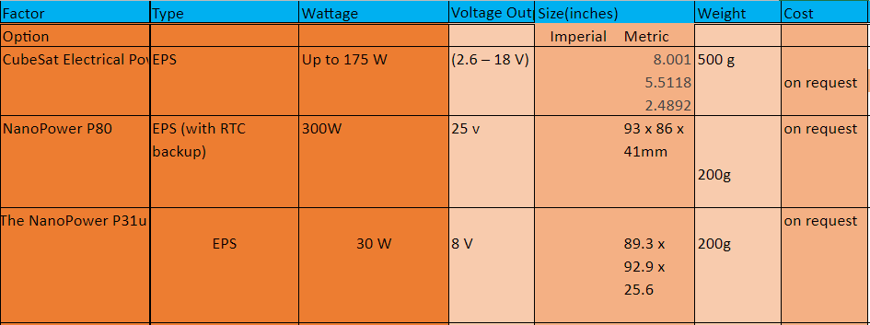
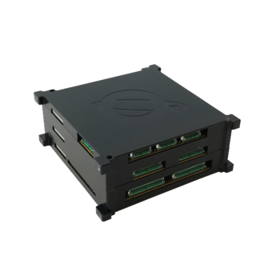
Power Supply Matrix

Slide 12
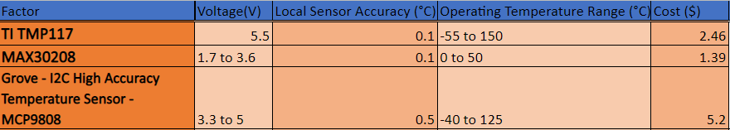
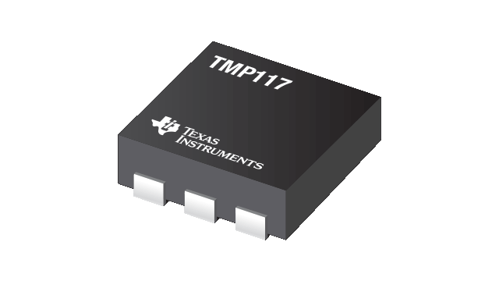
Precision Temperature Sensor

Slide 13
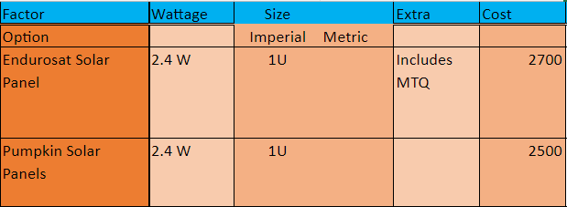
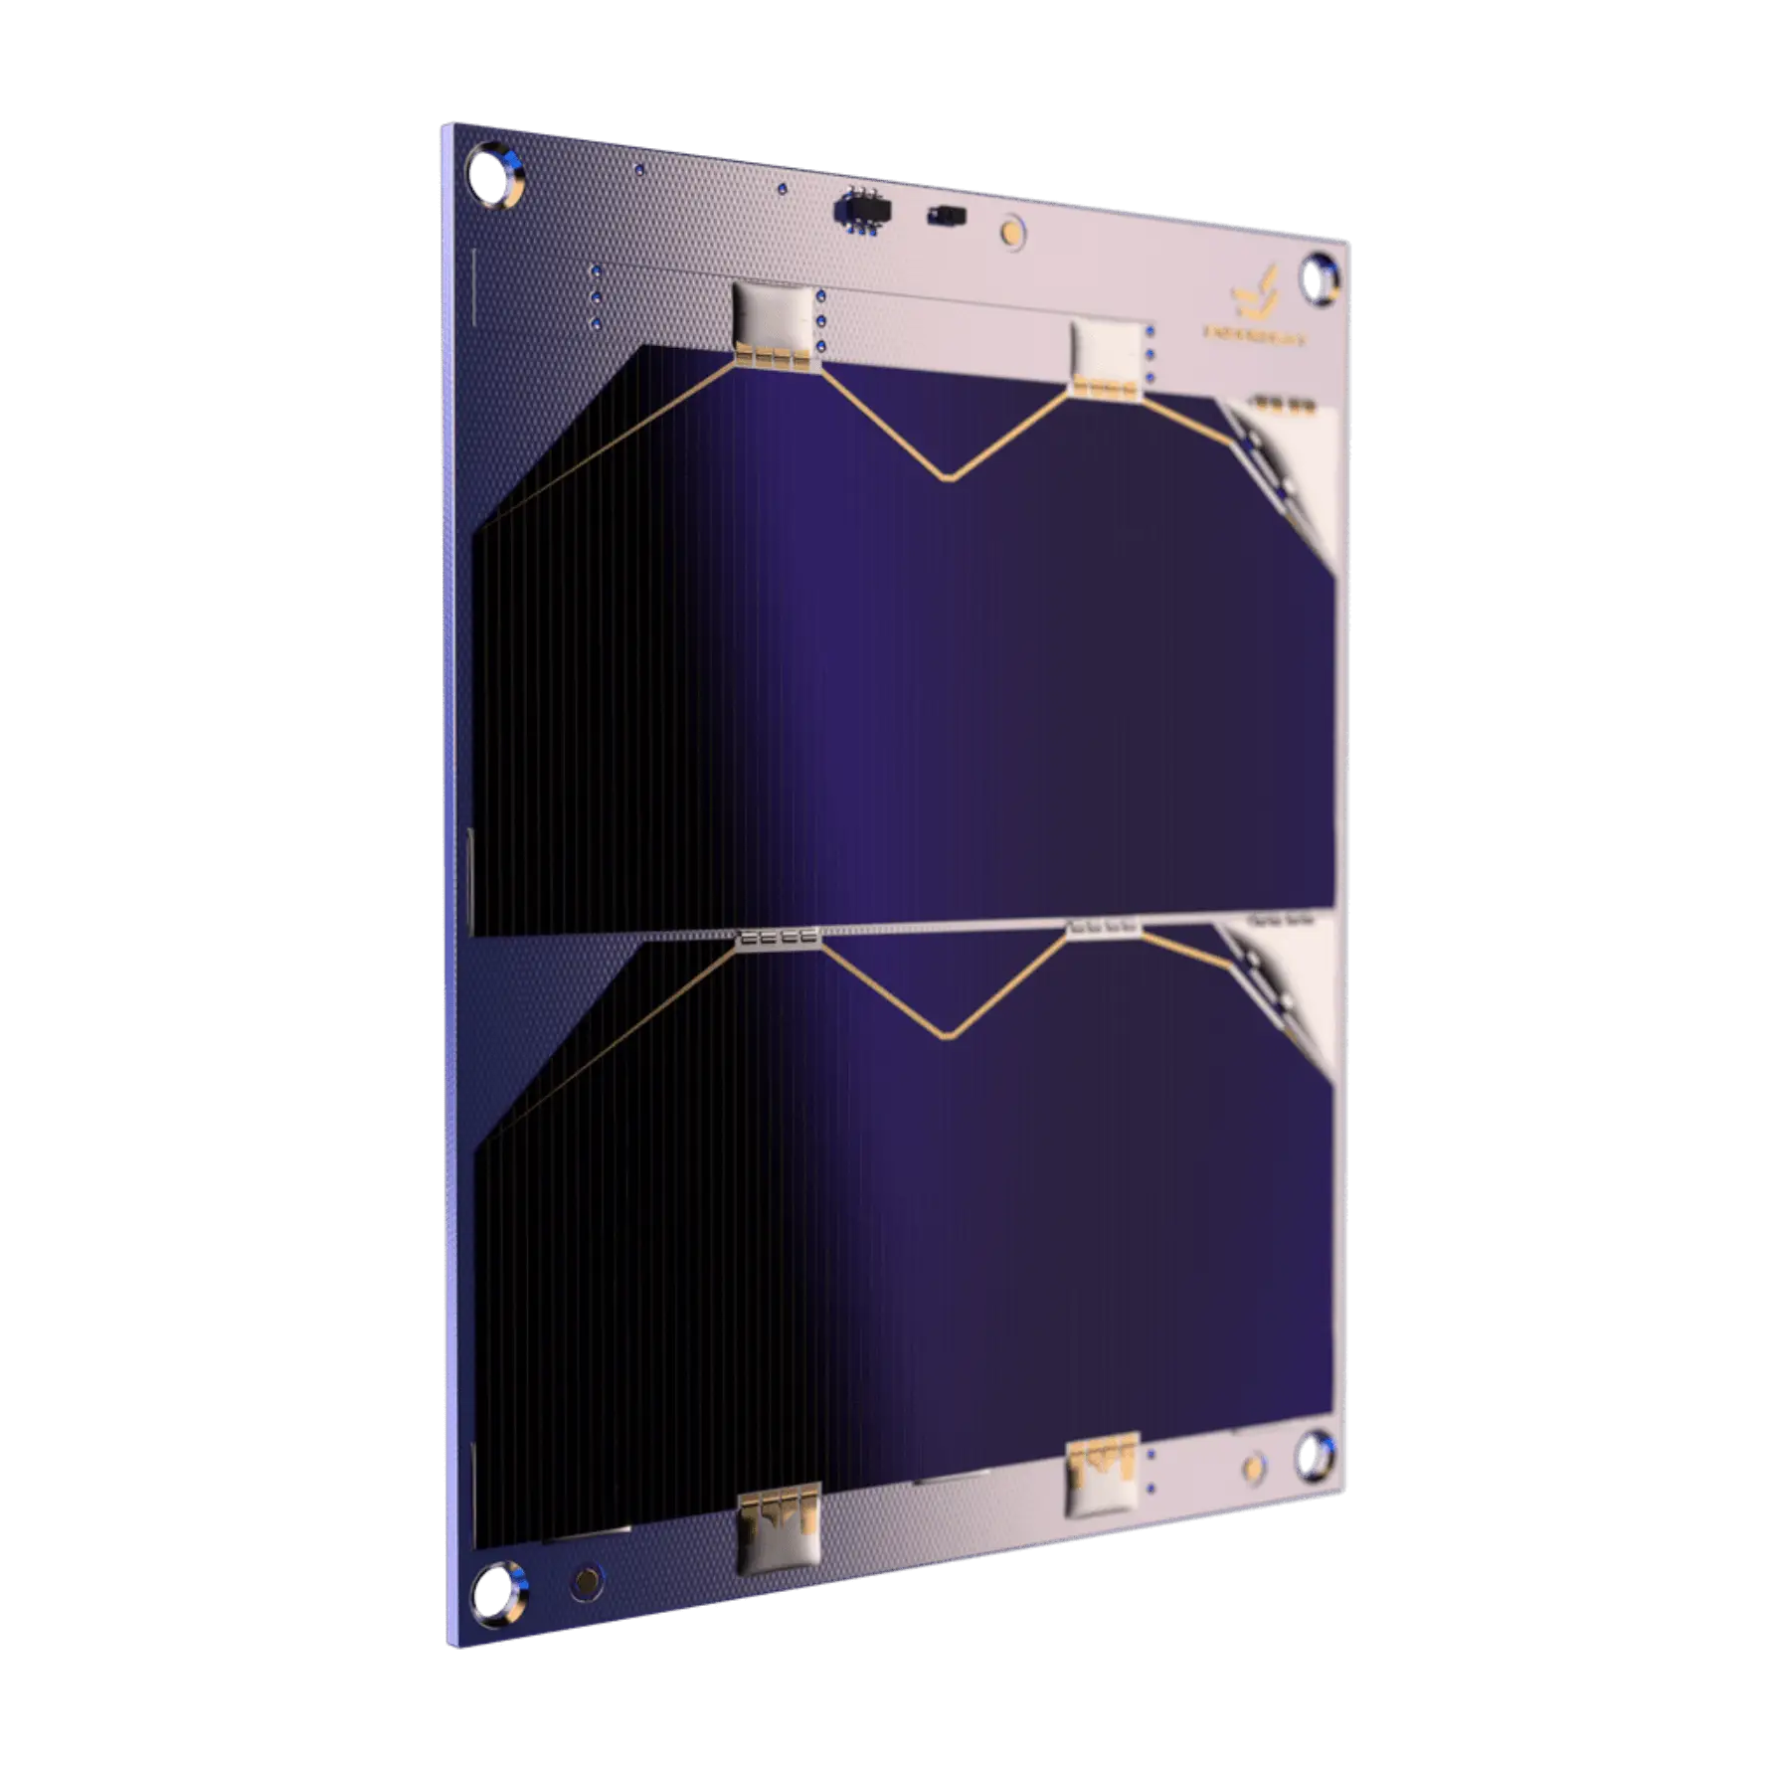
Solar Panel

Slide 14
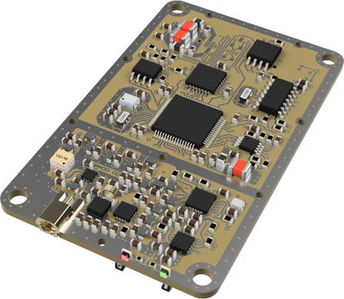
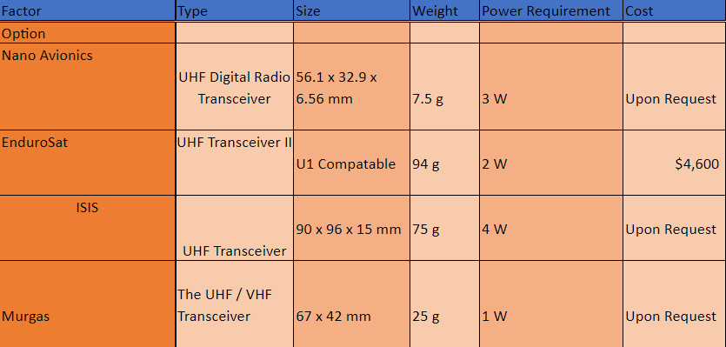
Transceiver

Slide 15
Specifications and Constraints
Specifications
Ultra-High Frequency and X band capable transceiver array
Cube Sat itself will be under 5kg
Communications array capable of comms up to 36,000 km
Two CPU’s which can reset eachother in case of error
Common interfaces for sensors (usb type c or serial)
Constraints
Cube Sat will be a 10x10x10cm structure (U1 cube)
Cube Sat itself will be under 5kg
Radiation shielding for CPU capable of protecting CPU from high earth orbit levels of radiation

Slide 16
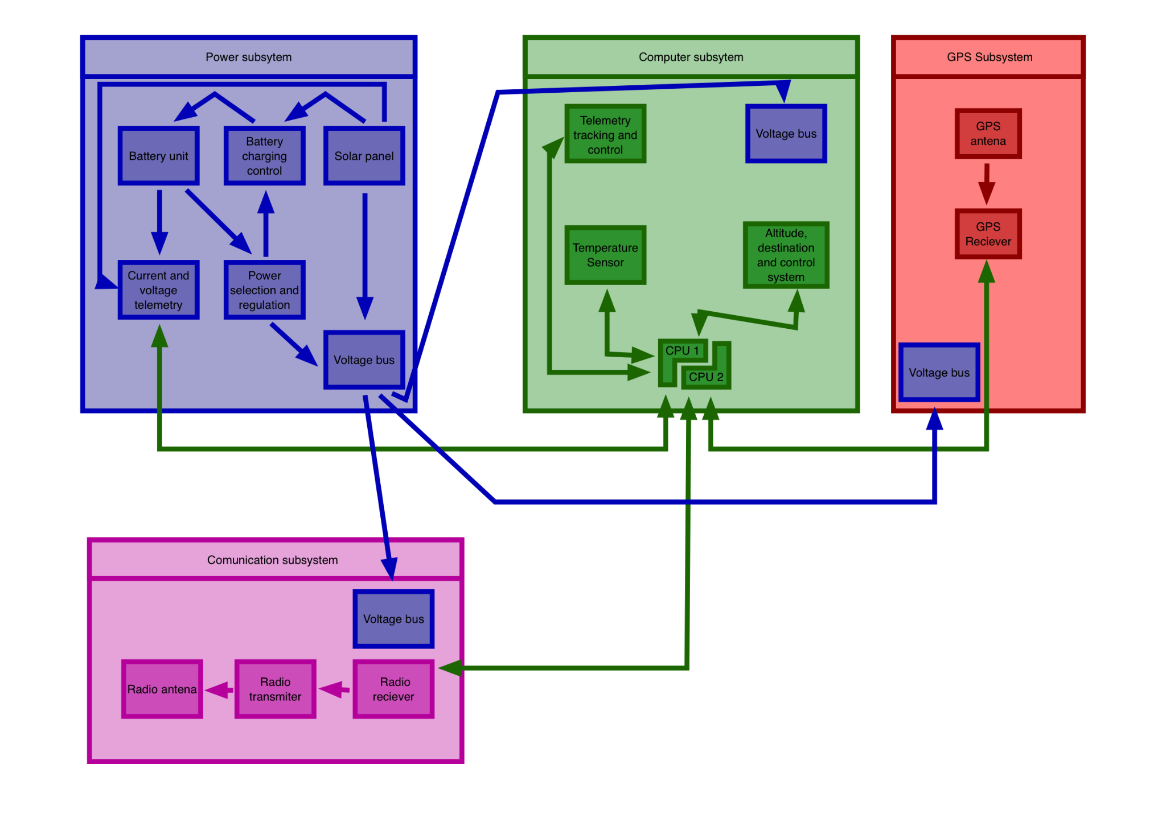
Block Diagram

Slide 17
Recommendations for next sprint
Research on utilizing and implementing an OS capable of being run on a Raspberry Pi that has the capability of interfacing with sensors, a communication array, and another Raspberry Pi
Create or modify an existing OS to include all functionality listed above
Increase general familiarization with Raspberry Pi hardware
Begin the process of acquiring funding for each of the parts we need, as many of them have a long period of time between ordering and delivery

Slide 18
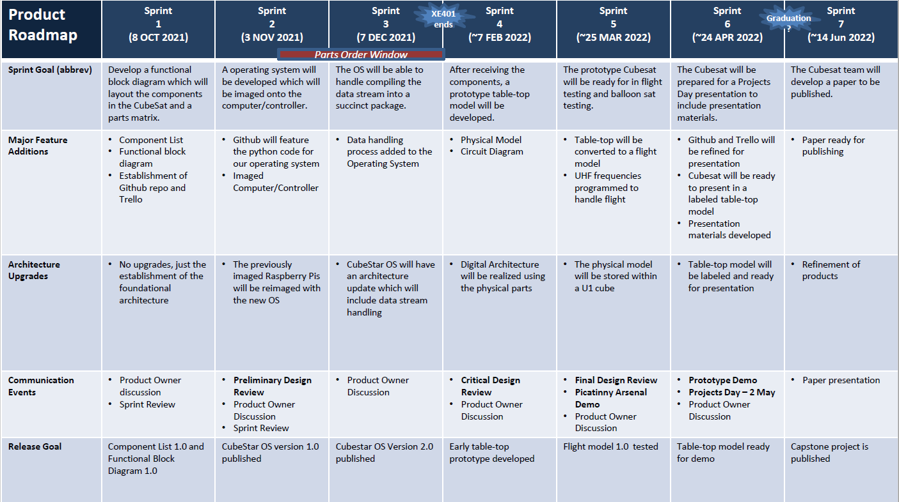
XE401/402 Product Roadmap

